Slide 1
Advanced Analysis (Two Temperature Model)

Slide 2
Preparation of the files (prerequisites)
One file (output of TxtShuffle or Nematicity). Two channels (from Nematicity) should be treated separately. Another option – use average over two channels for TTM
File with the heat capacity (for CL(T), in mJ mol⁻¹K⁻¹).
User should know: Wavelength (of pump pulse, 800 nm default), FWHM of pump pulse, extinction coefficient (optical constant k), Reflectance, electron heat capacity coefficient (Sommerfeld coefficient gamma γ (mJ mol⁻¹K⁻²)), density of material (kg m⁻³), and molar weight (kg/mol).
Additionally, to estimate the photoinduced stress, one should provide Gruneisen lattice and electron constants.
Video explanation is given in the video TTMPrerequisites

Slide 3
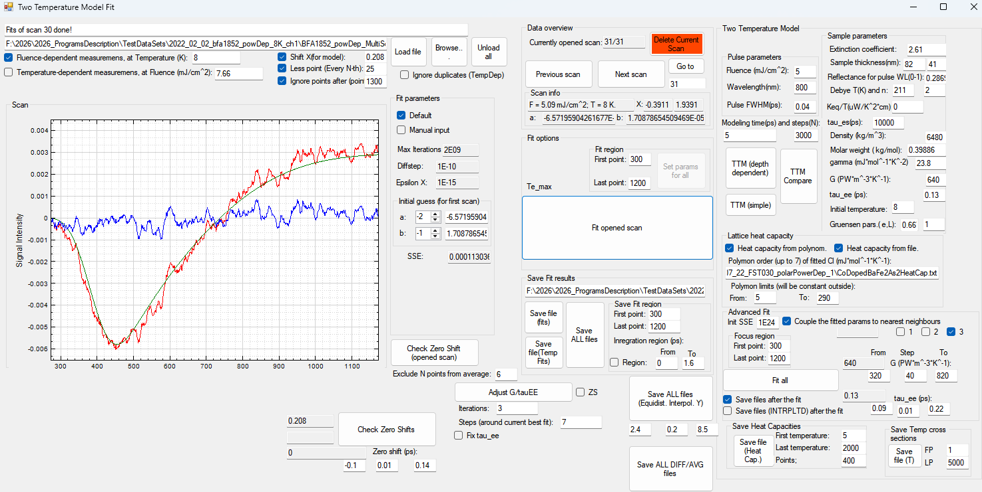
Overview of the MainWindow
Next sections are highlighted by different colorboxes:
File information, scan type, initial treatment
Pre-defined parameters for TTM* (in this case, G and tau_ee are user defined and can be used for Manual Fit)
Manual Fit section
Lattice Heat Capacity
AutoFIt routine (“Advanced Fit”)
Save Files (should be used if “save files after the fit” options are not chosen)
Zero Shift check (optional)
Elements from previous versions that do not work/ Other
Detailed explanation of all UI elements is given in the video TTMOverview

Slide 4
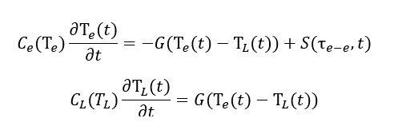
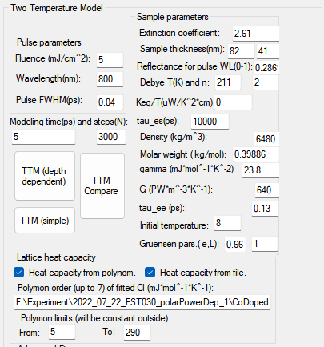

All required parameters for the fitting (TTM)
Color boxes show which parameters correspond to which term in TTM. Black boxes show the “fitting” parameters, that are being obtained from TTM.
All parameters are saved into the LastScanTextBoxes.fts when the user clicks “Fit all” (Advantec Fit routine)
Video explanation is given in the video TTMPrerequisites

Slide 5
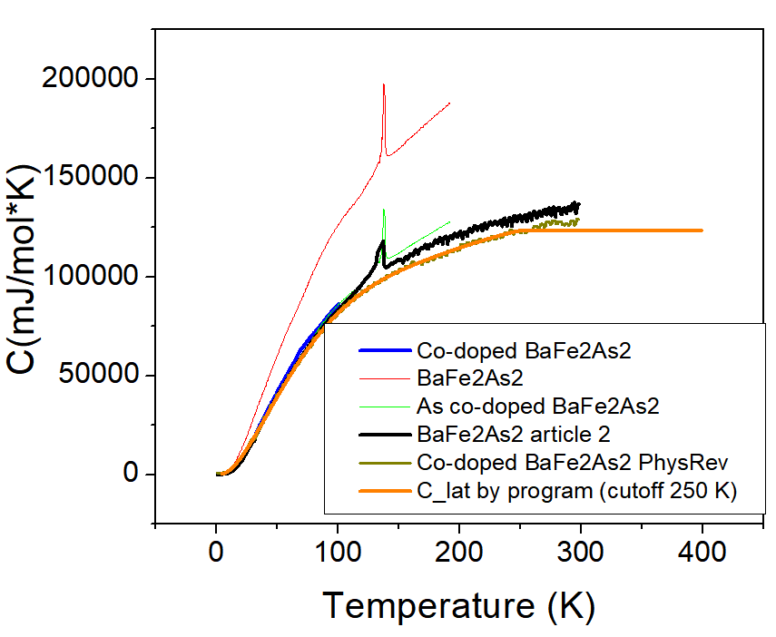
Heat Capacity (Lattice)
At low temperatures, the best approach is to find the heat capacity from prior literature, digitize it, and save as two coloumn file (tab separated, from Origin)
Video explanation is given in the video TTMPrerequisites

Slide 6
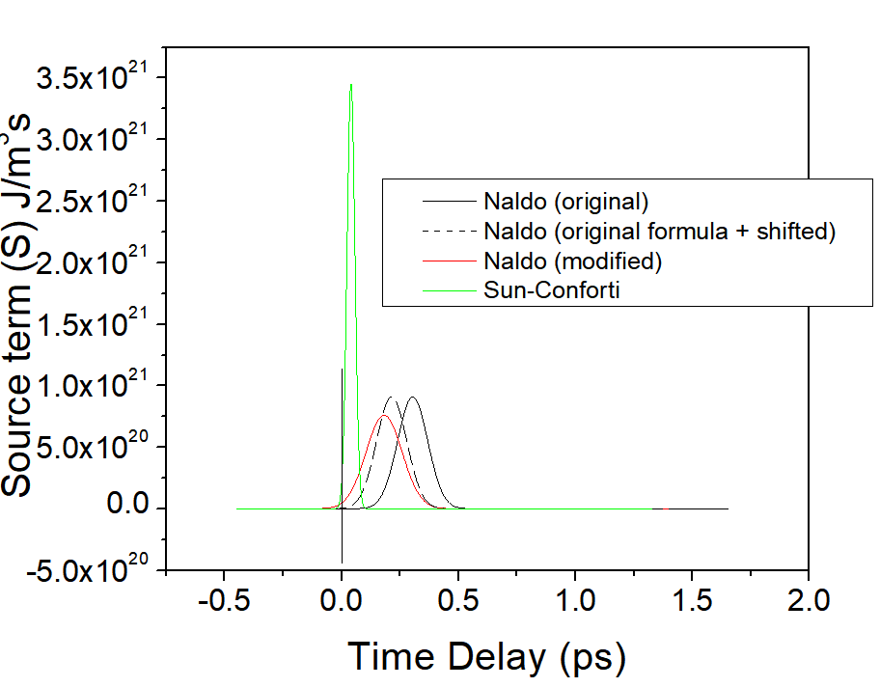
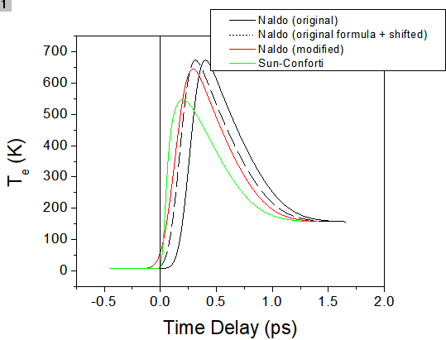
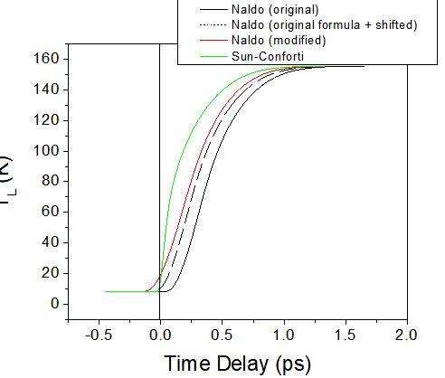
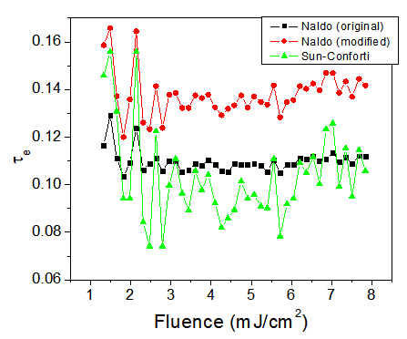
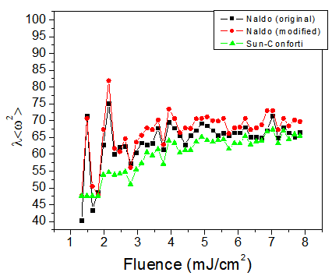
Zero Shift
Due to using Naldo et al. (2020) TTM, the source term S(t), that is initially includes only the laser pulse, broadens, leading to actificial shift of the time of arrival of the “pulse”. To reduce the difference between the model with the correct source term and modified source term, shift should be introduced. This shift does not affect the constants, obtained from the fit. (But modifying the model does)

Slide 7
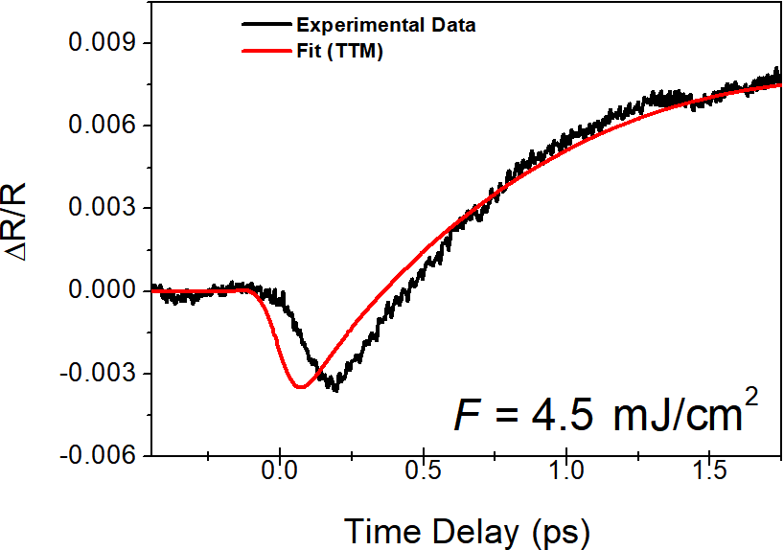
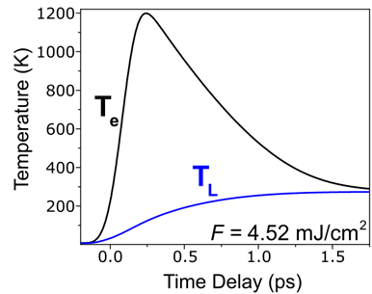
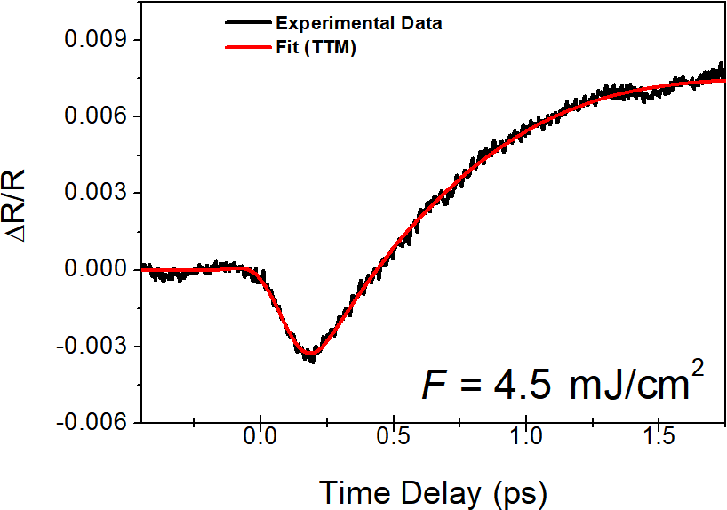

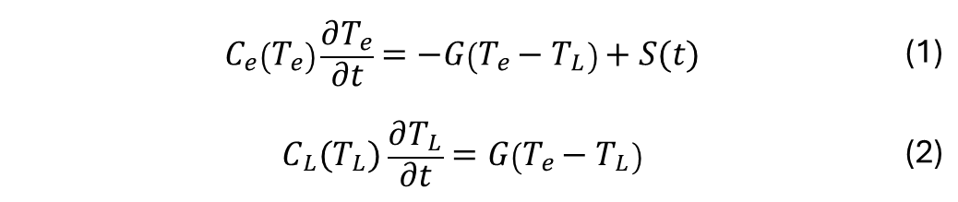
Program Main Routine (TTM fit of ΔR/R Data)
Make an estimation of G, and τ_{e-e} [parameter inside S(t)]
1
 | $$C_{e}\left(T_{e}\right)\frac{∂T_{e}}{∂t}=−G\left(T_{e}−T_{L}\right)+S(t)$$ | (1)
 | $$C_{L}(T_{L})\frac{∂T_{L}}{∂t}=G\left(T_{e}−T_{L}\right)$$ | (2)
Adjust G, and τ_{e-e} [parameter inside S(t)]
4
2
Repeat steps 1-4 until
G, and τ_{e-e} are optimized
5
5
 | $$\frac{∆R}{R}\left(t\right)=a∆T_{e}\left(t\right)+b∆T_{L}(t)$$ | (3)
3

Slide 8
First Manual Fits, Zero Shift
1) Make sure the parameters are correct for the current sample \ material
2) Select the file (using Browse button), check the correct measurement set type, enter correct temperature \ fluence. Enter the guess parameters (Shift X, Less points, Ignore points after ) – to get the right scan size \ number of points. Click Load file. If the choice is not satisfactory, change the parameters, click Load again.
3) Set the correct Fit region. Fit opened scan manually (optionally – choose the one scan with the best signal – to-noise \ cleanest signature – to identify the “0” shift).
4) Adjust G and tau_ee
5) If needed, change “Shift X” parameter, re-load the file (using Load file button)
6)Fit the scan again
Repeat 4-6 until satisfied.
7) (Optional) Click Check Zero Shift (opened scan) to verify the current zero shift is adequate
Video explanation is given in the video TTMFirstManualScans
2,5
3*
1,4
3,6
7

Slide 9
Automatic Fit Routine
If all parameters already known \ zero shift identified (check TTMFirstManualScans) then:
1) Select the file (using Browse button), check the correct measurement set type, enter correct temperature \ fluence. Enter the guess parameters (Shift X, Less points, Ignore points after ) – to get the right scan size \ number of points. Click Load file.
2) Set the approximate bounadies for the Fit region. Click “Fit all”
3) If needed, save the files separately.
Video explanation is given in the video TTMAdvFitRoutine
1
3
2
3

Slide 10
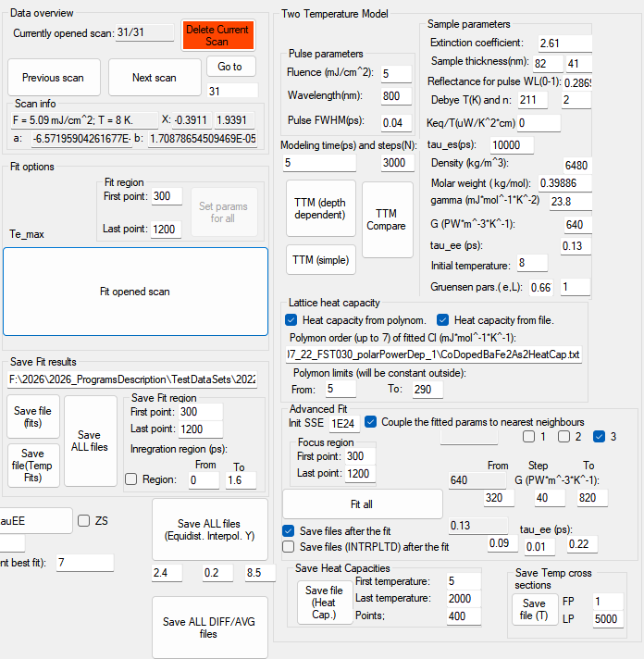
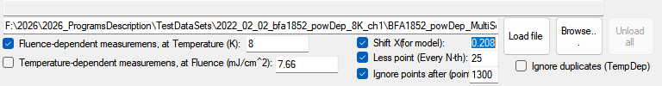
Depth-Dependent Modeling
1
1) Make sure all parameters are appropriately set up.
2) Make sure the path to heat capacity file is correct.
3) Click “TTM (depth dependent) or TTM Compare to model (modeling only).
Video explanation is given in the video TTMDepthDependent
3
2

